Slide 1
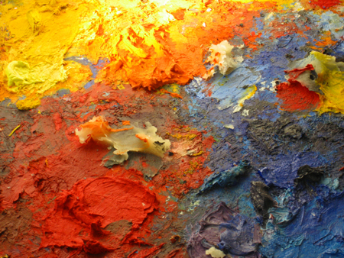
Introduction to Color
Part II

Slide 2
Lecture Roadmap
Color spaces—why? their rationales, and pros and cons (RGB, HSV, CIE, etc.)
How color spaces influence color picking
How to use color: some Dos and Don’ts
Notes:
Edit: added CIE

Slide 3
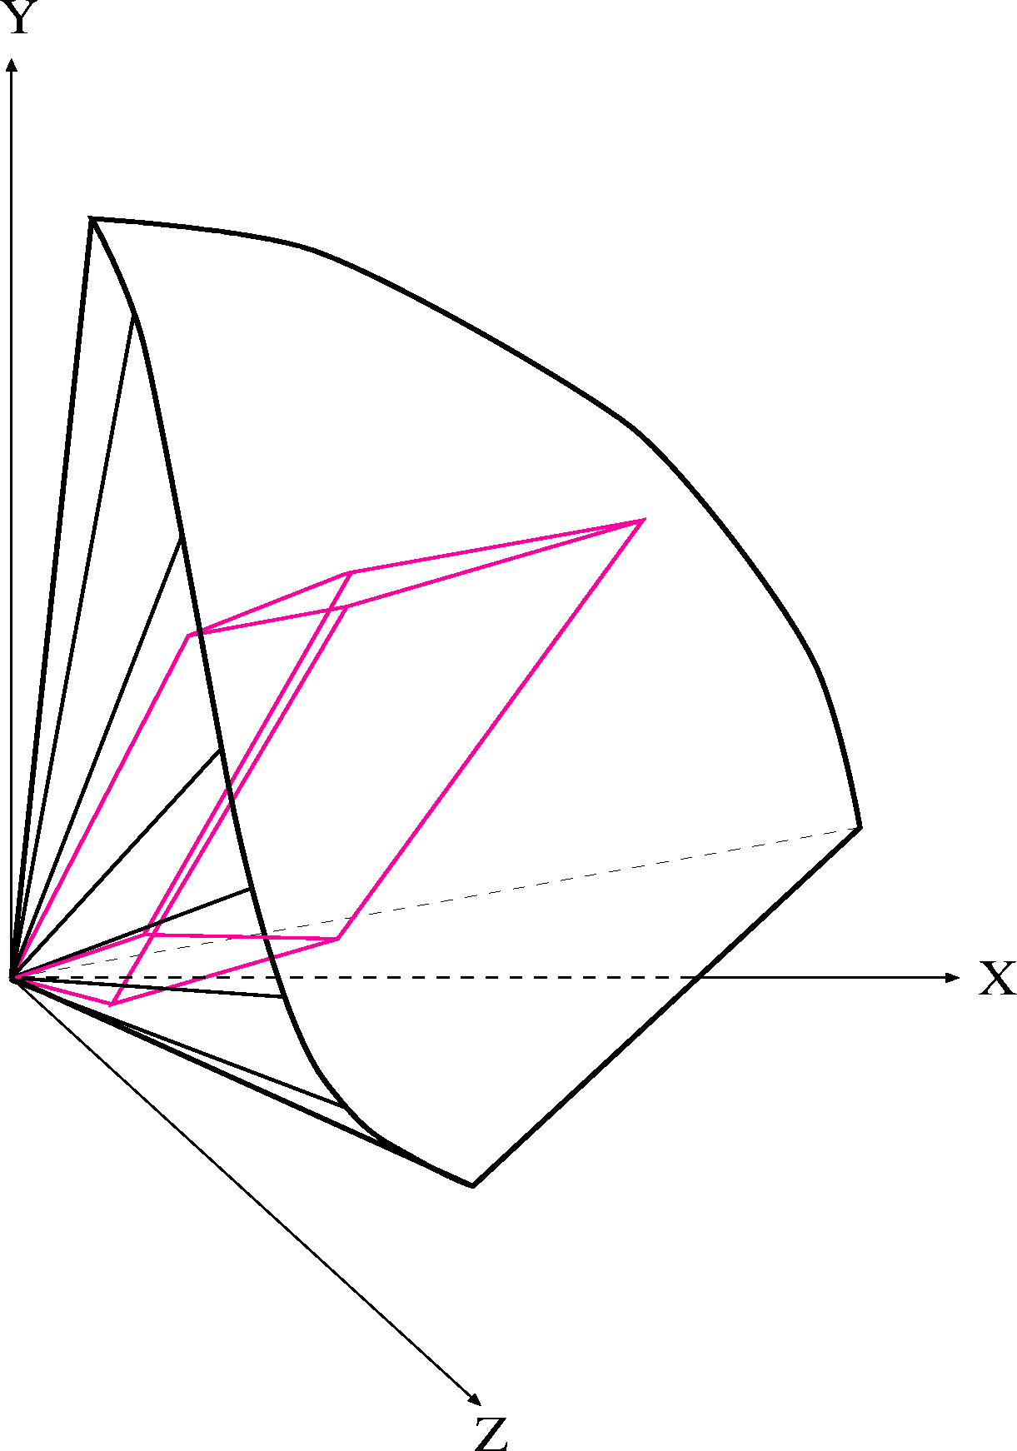
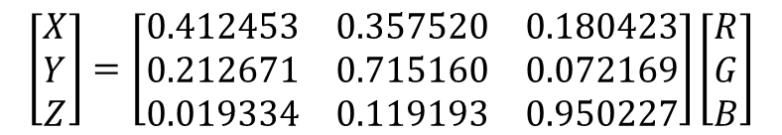
CIE Space Showing an RGB Gamut
Note irregular shape of visible gamut in CIE space; due to eye's response as measured by response curves
Range of displayable colors clearly smaller than all colors visible in XYZ space.
Note RGB cube is distorted because of projection used
color gamut for typical RGB color monitor within XYZ color space
$$\left[\begin{matrix}X \\ Y \\ Z\end{matrix}\right]=\left[\begin{matrix}0.412453 & 0.357520 & 0.180423 \\ 0.212671 & 0.715160 & 0.072169 \\ 0.019334 & 0.119193 & 0.950227\end{matrix}\right]\left[\begin{matrix}R \\ G \\ B\end{matrix}\right]$$

Slide 4
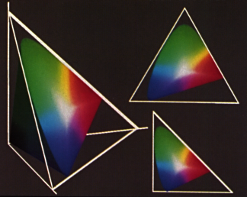
CIE Space Projection to Chromaticity Diagram
Left: X + Y + Z = 1 plane embedded in CIE space
Top right: view perpendicular to plane
Bottom right: projection of X+Y+Z=1 plane onto (X, Y) plane (i.e., Z = 0 plane). This is called the chromaticity diagram, used to:
Show Chromaticity – color (H, S), not luminance/brightness
Name colors
Define color mixing
Define and compare color gamuts
Several views of X + Y + Z = 1 plane of CIE space

Slide 5
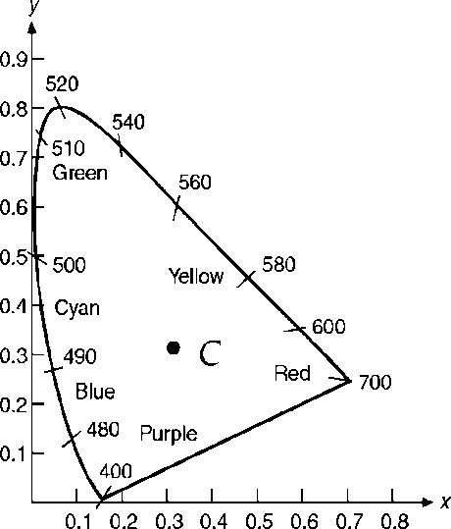
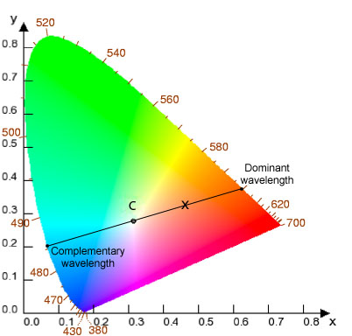
CIE Chromaticity Diagram
Spectral locus made up of chromaticity coordinates of monochromatic light.
Outside locus bounds -> not a visible color.
CIE chromaticity diagram is projection onto (X, Y) plane of X + Y + Z = 1 plane
Plots x, y for all visible chromaticity values
colors with same chromaticity map into same point regardless of luminance
spectrally pure, monochromatic colors on curve
points on a line are non-spectral, a mix of two monochromatic colors (e.g., “violet” and “red”)
colors that are luminance-related are not shown
e.g., brown = orange-red chromaticity at low luminance
infinite number of planes that project onto (X + Y + Z = 1) plane, whose colors all differ; NOT a full color palette!
illuminant C: near (but not at) x = y = z = 1/3; close to daylight
Spectral locus closed by line spanning a blue and a red

Slide 6
Hue and Dominant Wavelength seen Geometrically
X is a non-spectral (i.e., non-monochromatic) color : a mixture of white and dominant wavelength indicated by where line from C through point hits spectral locus
Excitation Purity : difference from illuminant's C relative to furthest point on chromaticity diagram with same hue - how pure (saturated) color is

Slide 7
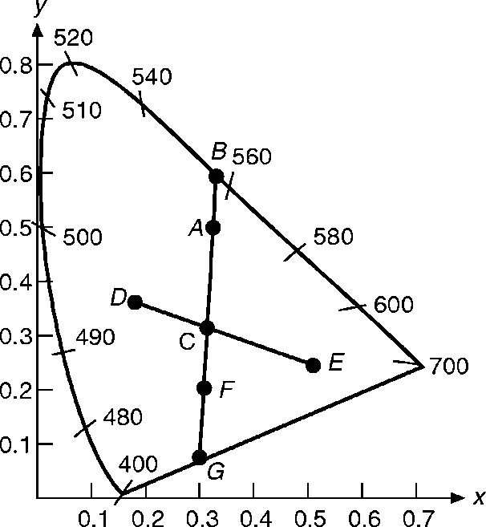
Using the Chromaticity Diagram
Measure dominant wavelength and excitation purity of any color:
Especially useful because color can be specified even when it can’t be accurately displayed on RGB monitor or printed, etc.
Matched color is at point A
B is a spectral color defined by the dominant wavelength
Mixture of two colors always on line between them => A = tC + (1– t)B where B is a spectral color and t measures distance from B to C
ratio AC/BC is excitation purity of A
NB: this is a more accurate “polar coordinate system” than circular color pickers

Slide 8
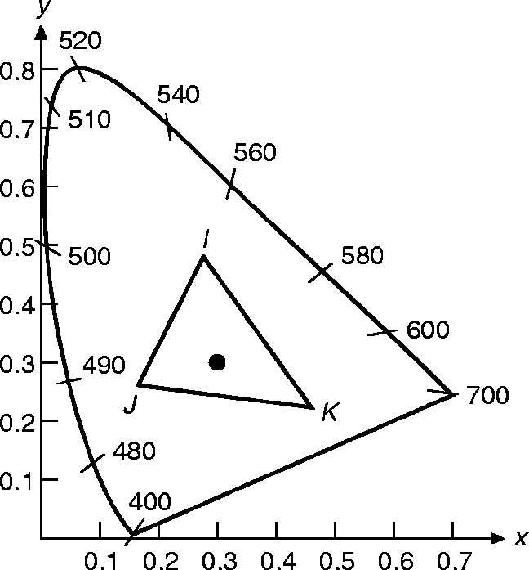
Color Mixing/Color Gamuts (1/2)
Colors add linearly in CIE: All mixtures of I and J lie on line connecting them
Thus, all possible mixtures of I, J and any third color, K, (or additional colors) lie within their convex hull, the color gamut
Also, no finite number of primaries can include all visible colors because hull is smaller than perimeter of diagram
DEMO: http://www.cs.rit.edu/~ncs/color/a_chroma.html

Slide 9
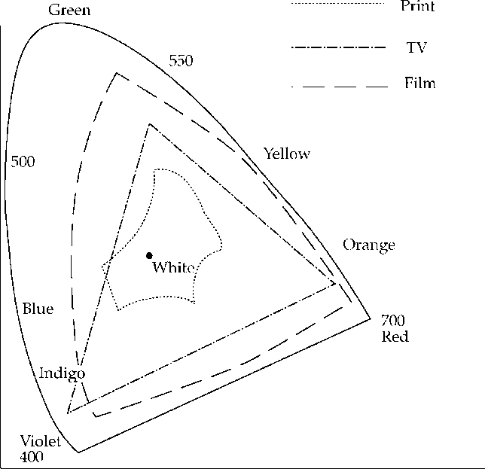
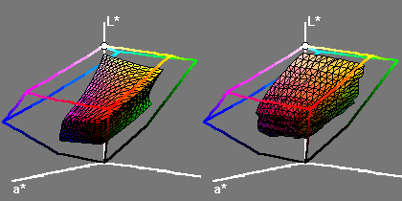
Color Mixing/Color Gamuts (2/2)
Smallness of print gamut with respect to color monitor gamut means faithful reproduction by printing must use reduced gamut of colors on monitor
Left: gamut of printer Right: gamut of monitor
Notes:
Gamuts shown in some type of perceptual CIE space

Slide 10
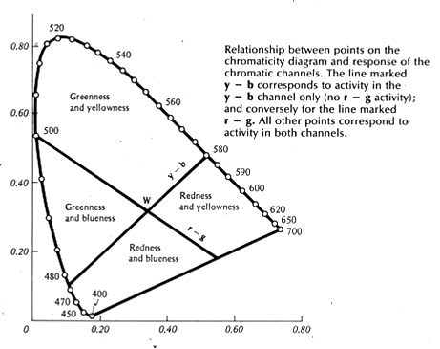
Chromatic Opponent Channels
From Falk’s Seeing the Light, Harper and Row, 1986
Can describe all colors in terms of red-green and yellow-blue—called psychological primaries (used in Adobe’s CIELab)
Notes:
Gamuts shown in some type of perceptual CIE space

Slide 11
Lecture Roadmap
Color spaces—why? their rationales, and pros and cons (RGB, HSV, CIE, etc.)
How color spaces influence color picking
How to use color: some Dos and Don’ts
Notes:
Edit: added CIE

Slide 12
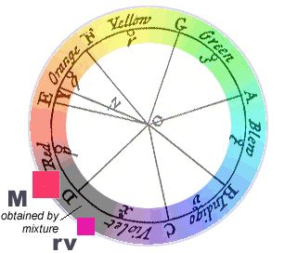
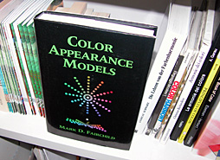
Color Spaces
A color space is a way of ordering colors in one, two, three (or more) geometric dimensions
From 600BC to 1600AD colors usually ordered by brightness.
Newton demonstrated familiar “rainbow” ordering of white light through a prism
Newton also first to arrange colors in a circle
Key aspect of color science
By Mark D. Fairchild
Notes:
Edit: added CIE

Slide 13
Color Models for Raster Graphics
Different situations suggest different ways of talking about colors
Unambiguous industry standards—requires something like CIE space.
Programming for monitors easier in space defined by monitor : RGB space (RGB pixels for both CRT’s and flat panels)
Printers use CMY (cyan, magenta, yellow) for color printing: CMY(K) space
Six-primary-color projection system: 6-color IRODORI space
User-friendliness: Hue, Saturation, Value is easier than RGB
Need perceptual uniformity in the space? Munsell or CIELab
Etc. You can make up your own color spaces too…

Slide 14
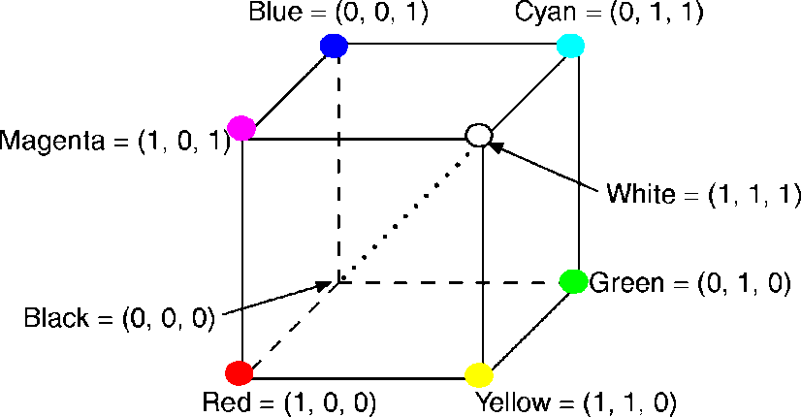
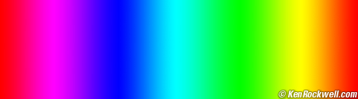
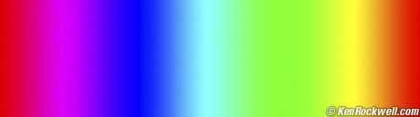
The RGB Color Model (1/3)
RGB primaries are additive
The RGB cube (Grays are on the dotted main diagonal)
Main diagonal => gray levels
black is (0, 0, 0)
white is (1, 1, 1)
RGB color gamut
differs from one monitor to another
differs by company too:
Adobe RGB - larger space
sRGB (HP/Microsoft) - fewer colors, but allocated bit depth better and more than enough for most on-screen and Web uses
sRGB
http://www.cambridgeincolour.com/tutorials/sRGB-AdobeRGB1998.htm
Adobe RGB

Slide 15
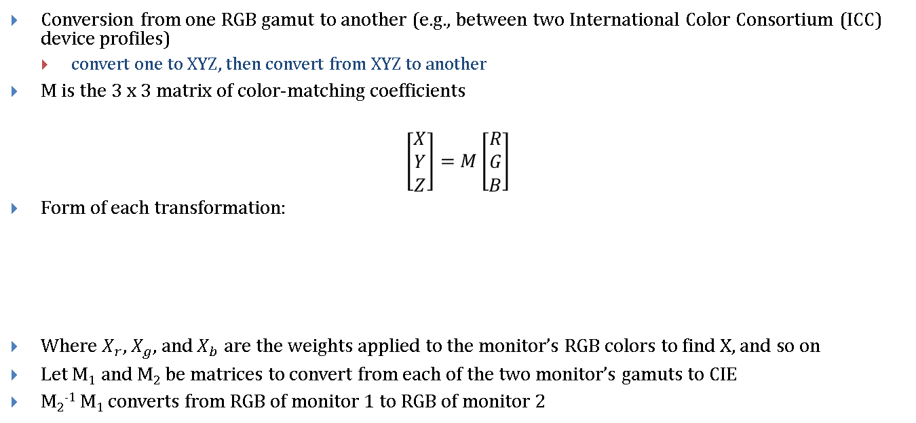
The RGB Color Model (2/3)
Conversion from one RGB gamut to another (e.g., between two International Color Consortium (ICC) device profiles)
convert one to XYZ, then convert from XYZ to another
M is the 3 x 3 matrix of color-matching coefficients
$$\left[\begin{aligned}X \\ Y \\ Z\end{aligned}\right]=M\left[\begin{aligned}R \\ G \\ B\end{aligned}\right]$$
Form of each transformation:
Where $X_{r}$, $X_{g}$, and$X_{b}$ are the weights applied to the monitor’s RGB colors to find X, and so on
Let M₁ and M₂ be matrices to convert from each of the two monitor’s gamuts to CIE
M₂⁻¹ M₁ converts from RGB of monitor 1 to RGB of monitor 2
Notes:
Conversion tables example http://www.boscarol.com/pages/cms_eng/030-conv.html
ICC (International Color Consortium) http://www.color.org/

Slide 16
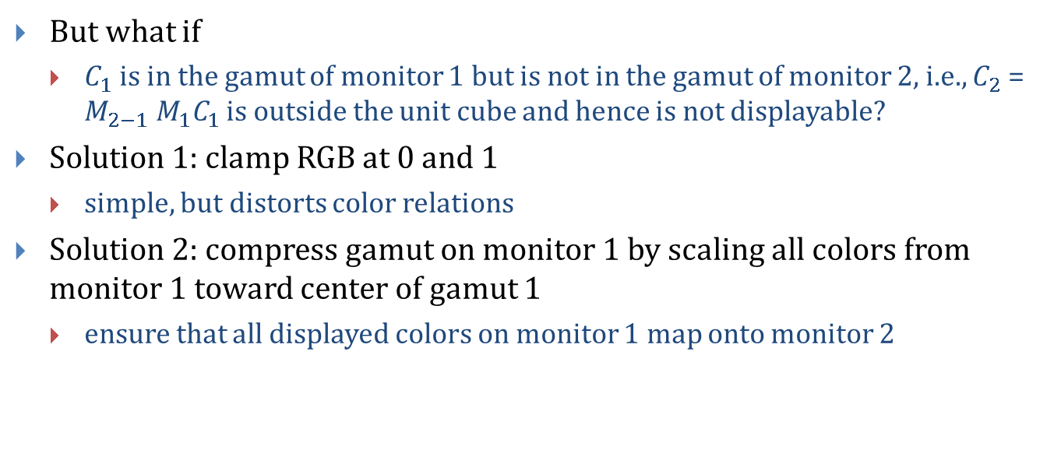
The RGB Color Model (3/3)
But what if
$C_{1}$ is in the gamut of monitor 1 but is not in the gamut of monitor 2, i.e., $C_{2}$ = $M_{2−1} M_{1}C_{1}$ is outside the unit cube and hence is not displayable?
Solution 1: clamp RGB at 0 and 1
simple, but distorts color relations
Solution 2: compress gamut on monitor 1 by scaling all colors from monitor 1 toward center of gamut 1
ensure that all displayed colors on monitor 1 map onto monitor 2

Slide 17
The CMY(K) Color Model (1/2)
Used in electrostatic and in ink-jet plotters that deposit pigment on paper
Cyan, magenta, and yellow are complements of red, green , and blue
Subtractive primaries: colors are determined by what is subtracted from white light, rather than by what is added to blackness
Cartesian coordinate system
Subset is unit cube
white is at origin, black at (1, 1, 1):
Green
Yellow
(minus blue)
(minus red)
Cyan
Black
Red
Blue
Magenta
(minus green)
subtractive primaries (cyan, magenta, yellow) and their mixtures

Slide 18
The CMY(K) Color Model (2/2)
Color printing presses, most color printers use CMYK (K = black)
K used instead of equal amounts of CMY
called undercolor removal
richer black
less ink deposited on paper – dries more quickly
First approximation – nonlinearities must be accommodated:
K = min(C, M, Y)
C’ = C – K
M’ = M – K
(one of C’, Y’, M’ will be 0)

Slide 19
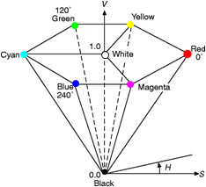
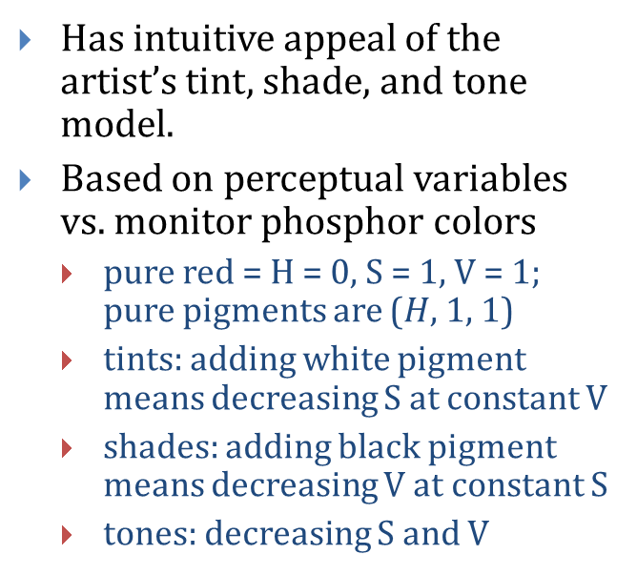
The HSV Color Model (1/2)
Hue, saturation, value (brightness)
HSV-space invented by Alvy Ray Smith—described in his 1978 SIGGRAPH paper, Color Gamut Transformation Pairs.
Hexcone subset of cylindrical (polar) coordinate system
Single hexcone HSV
color model. (The
V = 1 plane contains
the RGB model’s
R = 1, G = 1, B = 1,
in the regions shown)
Has intuitive appeal of the artist’s tint, shade, and tone model.
Based on perceptual variables vs. monitor phosphor colors
pure red = H = 0, S = 1, V = 1; pure pigments are ($H$, 1, 1)
tints: adding white pigment means decreasing S at constant V
shades: adding black pigment means decreasing V at constant S
tones: decreasing S and V
Notes:
But “adding white” and “adding black” not inverse operations.
HWB-A More Intuitive Hue-Based Color Model (with Eric Ray Lyons)
the journal of graphics tools, Vol 1, No 1: 3-17, 1996

Slide 20
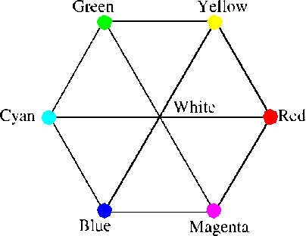
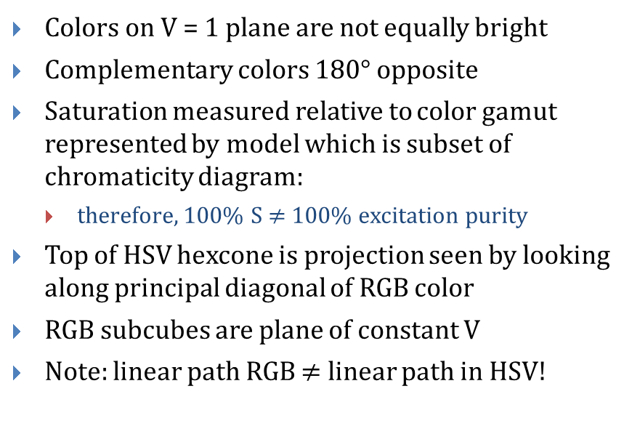
The HSV Color Model (2/2)
Colors on V = 1 plane are not equally bright
Complementary colors 180° opposite
Saturation measured relative to color gamut represented by model which is subset of chromaticity diagram:
therefore, 100% S $≠$ 100% excitation purity
Top of HSV hexcone is projection seen by looking along principal diagonal of RGB color
RGB subcubes are plane of constant V
Note: linear path RGB $≠$ linear path in HSV!
RGB color cube viewed along the principal diagonal

Slide 21
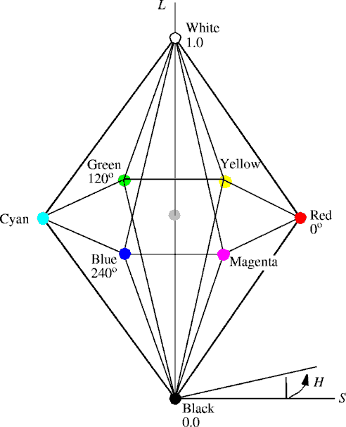
The HLS Color Model
Hue, lightness, saturation
Double-hexcone subset
Maximally saturated hues are at S = 1, L = 0.5
Less attractive for sliders or dials
Conceptually easier for some people to view white as a point

Slide 22
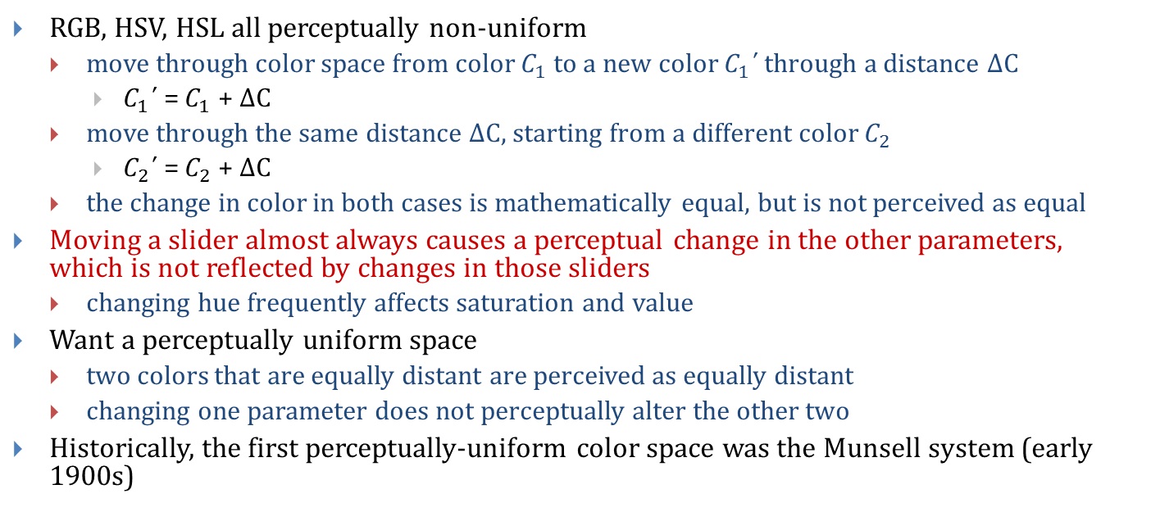
Perceptual Uniformity (or lack thereof)
RGB, HSV, HSL all perceptually non-uniform
move through color space from color $C_{1}$ to a new color $C_{1}$΄ through a distance ΔC
$C_{1}$΄ = $C_{1}$ + ΔC
move through the same distance ΔC, starting from a different color $C_{2}$
$C_{2}$΄ = $C_{2}$ + ΔC
the change in color in both cases is mathematically equal, but is not perceived as equal
Moving a slider almost always causes a perceptual change in the other parameters, which is not reflected by changes in those sliders
changing hue frequently affects saturation and value
Want a perceptually uniform space
two colors that are equally distant are perceived as equally distant
changing one parameter does not perceptually alter the other two
Historically, the first perceptually-uniform color space was the Munsell system (early 1900s)

Slide 23
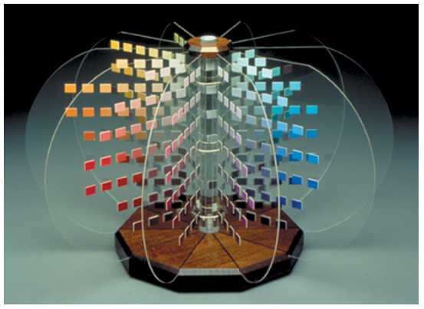
The Munsell System (1/2)
Created from perceptual data, is not a transformation of or approximation to CIE
Uniform perceptually based 3D space
accounts for the fact that a bright yellow is much lighter than a bright blue, and that many more levels of saturation of blue can be distinguished than of yellow
Magnitude of change in one parameter always maps to the same effect on perception

Slide 24

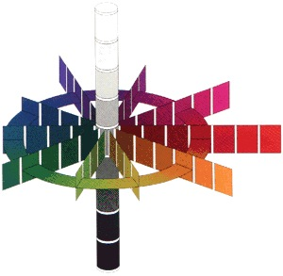
The Munsell System (2/2)
Hues (called chroma in Munsell) arranged on a circle
a 20° rotation through this circle causes the same perceptual change
does not cause changes in saturation or value
Saturation as distance from center of circle
moving a certain distance always causes the same perceptual change
does not cause changes in hue or value
Value as height in space
moving vertically causes the same perceptual change
does not cause changes in hue or saturation
Lightness
Hue/Chroma
Saturation

Slide 25
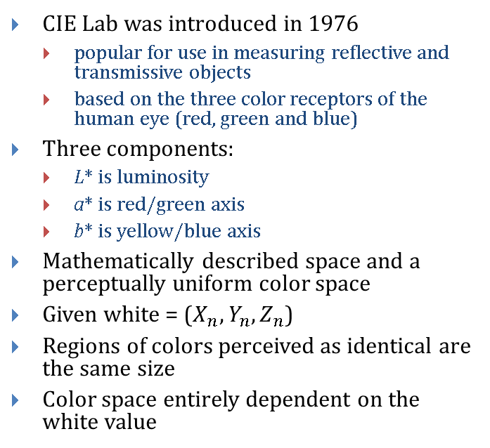
CIE Lab – a perception based color space
CIE Lab was introduced in 1976
popular for use in measuring reflective and transmissive objects
based on the three color receptors of the human eye (red, green and blue)
Three components:
L* is luminosity
a* is red/green axis
b* is yellow/blue axis
Mathematically described space and a perceptually uniform color space
Given white = ($X_{n}, Y_{n}, Z_{n}$)
Regions of colors perceived as identical are the same size
Color space entirely dependent on the white value

Slide 26
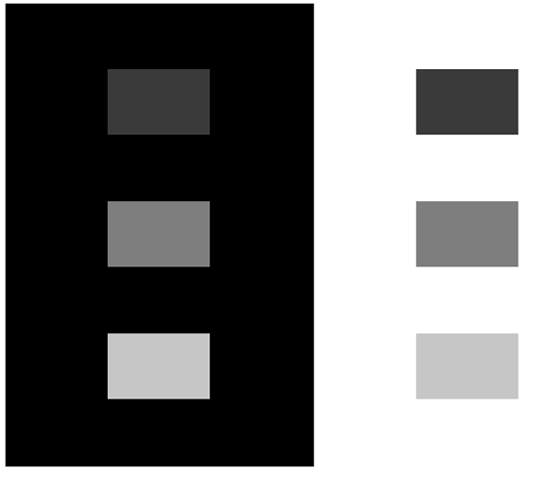
Bonus Color Space: CIECAM02 Color Appearance Model
These rectangles have the same pixel values.
http://scanline.ca/ciecam02/
Even perceptually developed spaces (like Munsell) don’t take into account color interactions
Example: the surround effect, shown left

Slide 27


Perceptual Effect Corrected For…
Same pixel values
Pixel values adjusted by CIECAM02

Slide 28
One More Time… with Color (1/2)
Same pixel values

Slide 29

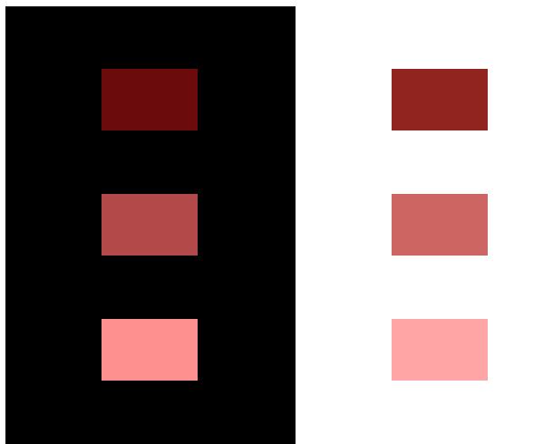
One More Time… with Color (2/2)
Same pixel values
Pixel values adjusted by CIECAM02

Slide 30
Color Model Pros and Cons (1/2)
RGB
+ Cartesian coordinate system
+ linear
+ hardware-based (easy to transform to video)
+ tri-stimulus-based
- hard to use to pick and name colors
- doesn’t cover gamut of perceivable colors
- non-uniform: equal geometric distance ->
unequal perceptual distance
HSV
+ easy to convert to RGB
+ easy to specify colors/intuitive
- nonlinear
- doesn’t cover gamut of perceivable colors
- non-uniform

Slide 31
Color Model Pros and Cons (2/2)
CIE
+ covers gamut of perceived colors
+ based on human perception
(matching experiments)
+ linear
+ contains all other spaces
- non-uniform (but variations such as CIE Lab
are closer to Munsell, which is uniform)
- xy-plot of chromaticity horseshoe diagram
doesn’t show luminance
CIE Lab space
+ perceptually uniform
+ based on psychological colors (y-b, r-g, w-b)
- terrible interface in Photoshop
- sliders used for a curved surface
- surface changes when L value changes
- no visualization of the color space
- very difficult to determine what values
mean if you are unfamiliar with the space
- primarily used as an internal space to
convert between RGB and CMYK

Slide 32
Lecture Roadmap
Color spaces—why? their rationales, and pros and cons (RGB, HSV, CIE etc.)
How color spaces influence color picking
How to use color: some Dos and Don’ts

Slide 33
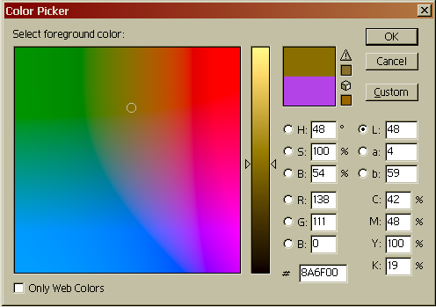
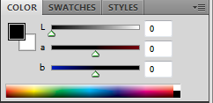
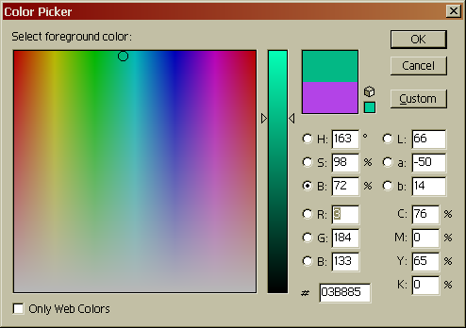
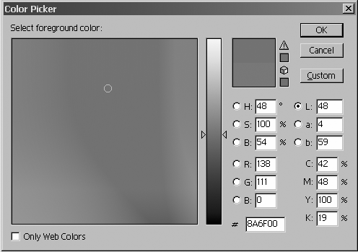
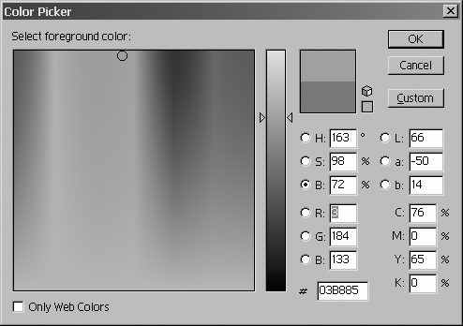
CIELab in Photoshop
Lab color space slice—constant value (L)
HSB color space slice—constant value (B)
Lab slides

Slide 34
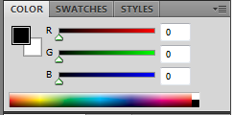
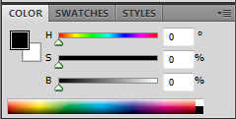
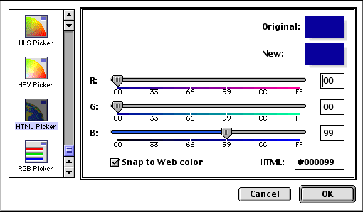
Interactive Specification of Color (1/3): Sliders
Adobe Photoshop
English-language names are ambiguous and subjective
Most programs use numeric coordinates in color space with slide dials:

Slide 35
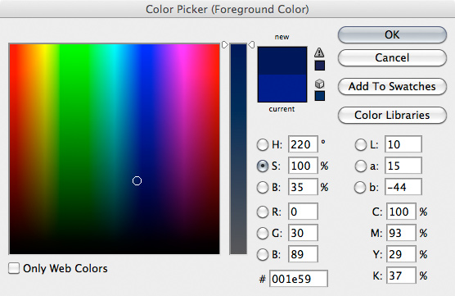
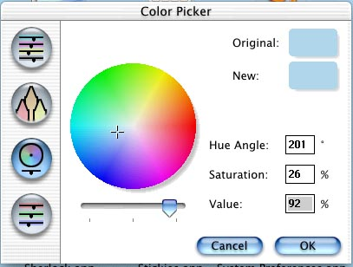
Interactive Specification of Color (2/3) : Geometric Views
Interact with visual representation of the color space
Important for user to see actual display with new color
Beware of surround effect!
HSB color picker from Adobe Photoshop
HSV color picker from Mac OS X’s Finder

Slide 36
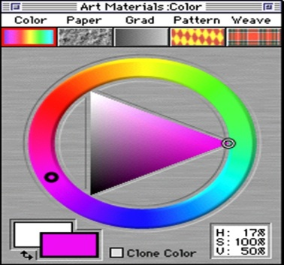
Interactive Specification of Color (3/3): Geometric Views, cont.
Corel Painter

Slide 37
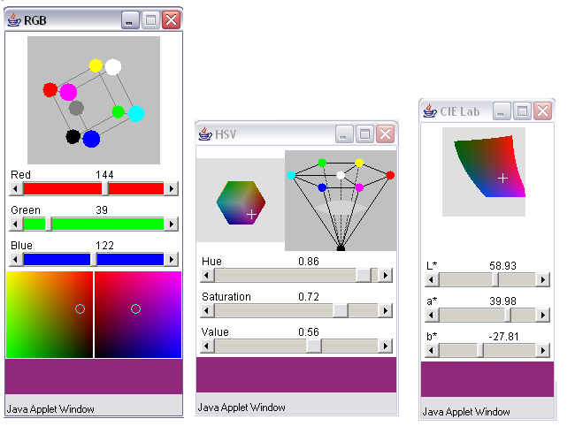
3D Color Pickers
http://www.cs.rit.edu/~ncs/color/a_spaces.html
3D spaces applet

Slide 38
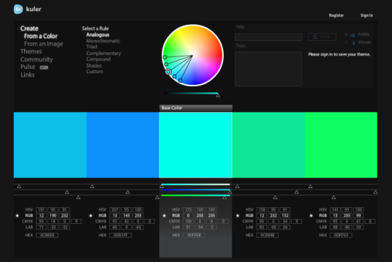
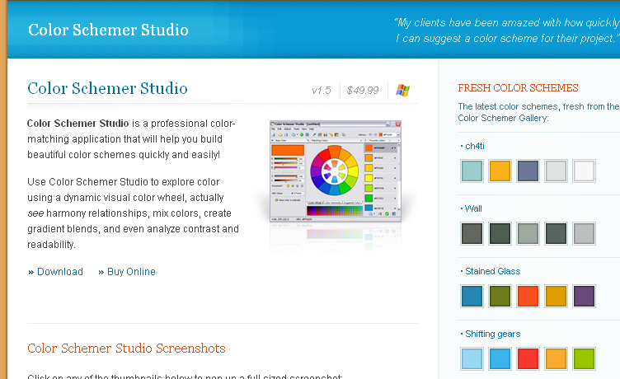
Some Commercial Alternative Pickers
A color wheel-based palette creator, based on a perceptual color space: http://www.colorschemer.com/
A relational palette creator, with HSV, RGB, CMYK, LAB, and HEX color pickers: http://kuler.adobe.com/

Slide 39
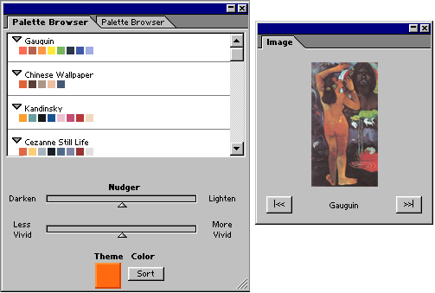
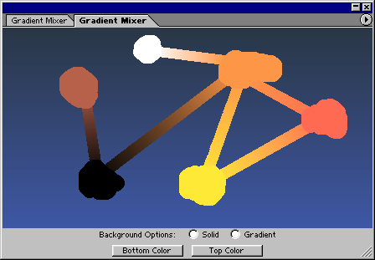
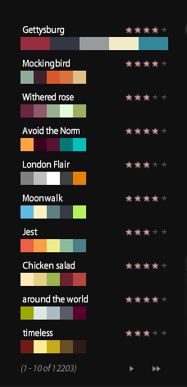
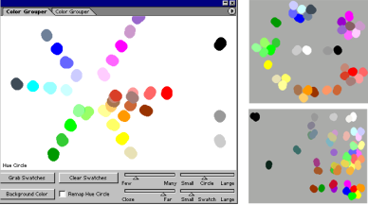
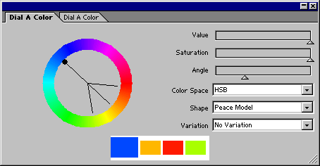
Interactive Palette Tools
Gradient Mixer
Adobe Kuler
Color Grouper
Palette Browser
Barb Meier, Anne Spalter, David Karelitz, CG&A Vol24, No 3, 2004 (sponsored by Adobe)
Dial-a-Color
Notes:
Research ….

Slide 40
Interpolating in Color Space (1/2)
Interpolation needed for:
Gouraud shading
antialiasing
blending images together in a fade-in, fade-out sequence
Results depend on the color model used:
RGB, CMY, YIQ, CIE are related by affine transformations, hence straight line (i.e., interpolation paths) are maintained during mapping
not so for HSV, HLS; for example, interpolation between red and green in RGB:
interpolating in HSV:
midpoint values in RGB differ by 0.5 from same interpolation in HSV:
(60º, 1, 0.5) (60º, 1, 1)
red = (1, 0, 0), green = (0, 1, 0)
midpoint = (0.5, 0.5, 0)
red = (0º, 1, 1); green = (120º, 1, 1)
midpoint = (60º, 1, 1)
RGB_to_HSV = (60º, 1, 0.5)

Slide 41
Interpolating in Color Space (2/2)
RGB, red is (1, 0, 0) and cyan is (0, 1, 1) which interpolate to (0.5, 0.5, 0.5), gray
in HSV, that is (UNDEFINED, 0, 0.5)
In HSV, red is (0º, 1, 1) and cyan is (180º, 1, 1) which interpolates to (90º, 1,1)
new hue at maximum value and saturation, whereas the “right” result of combining equal amounts of complementary colors is a gray value
(interpolating, transforming) (transforming, interpolating)
For Gouraud shading, use any of the models because interpolants are generally so close together that interpolation paths are close together
For blending two images, as in fade-in fade-out sequence or for antialiasing, colors may be quite distant
use additive model, such as RGB
If interpolating between two colors of fixed hue (or saturation), maintain fixed hue (saturation) for all interpolated colors by HSV or HLS
note fixed-saturation interpolation in HSV or HLS is not seen as having exactly fixed saturation by viewer!

Slide 42
Lecture Roadmap
Color spaces—why? their rationales, and pros and cons (RGB, HSV, CIEetc.)
How color spaces influence color picking
How to use color: some Dos and Don’ts

Slide 43
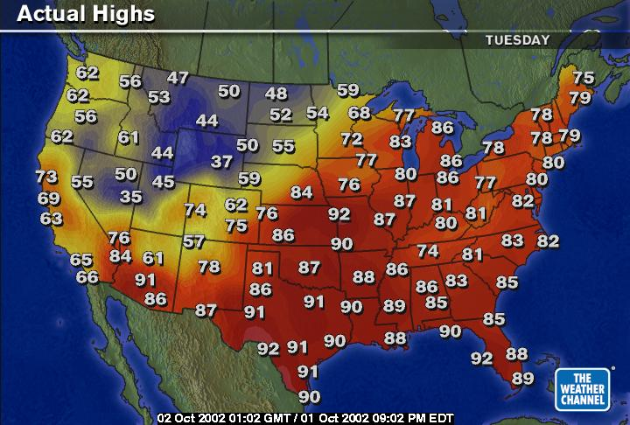
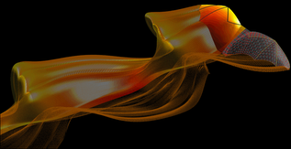
Using Color in Computer Graphics: Ask, “Why?”
Aesthetic uses?
establish a tone or mood
promote realism
Highlight features?
Code numeric quantities?
temperature across the U.S.
vegetation and mineral concentrations on Earth, moon, and planets (LandSat, Mars missions)
speed of fluids in computational fluid dynamics (streamlines)
(Color use guidelines from Barb Meier’s 1987 Brown CS Master’s Thesis, and unpublished web text)
Image from bat flight research being done at Brown
Notes:
Not all relevant to rendering—some of these more geared toward graphics design tasks.
Bat flight lab: https://sites.google.com/a/brown.edu/fluids/research/breuer-research/bat-flight-research

Slide 44



Choose Palette or Scheme
Color harmony:
choose a theme color
complementary colors for objects that should have a dynamic relationship with theme-colored objects
analogous (close together) colors close together to model light (shading) and for coloring objects close to each other
contrasting colors (especially value contrast) for text and background
Color circles can help with these choices
Expert palettes
Notes:
Not all relevant to rendering—some of these more geared toward graphics design tasks.
Bat flight lab: https://sites.google.com/a/brown.edu/fluids/research/breuer-research/bat-flight-research

Slide 45




Color palette books…

Slide 46
Assign Colors for Ease of Use/Reading/Viewing
Don’t use more colors than necessary (when in doubt use less color)
Ensure contrast of color between text and background (especially of value)
All else being equal, areas of saturated color will draw attention
Don’t use highly saturated colors of background
Large areas of intense color can lead to eye strain
Use colors that have greatest contrast with the background for most important items
If using several colors of foreground object, use a neutral background
Blue-family colors tend to recede while warmer red-family colors come forward
Notes:
For most people blue recede and red comes forward, but for a few the opposite is true.

Slide 47

Color Coding (1/2)
Do
Use families of color to code related items
Use a progression of values to code an ordered set (don’t use more than 5 steps if values need to be remembered)
Color code for accepted use in specific industry: red often means stop, but in power industry means go (electricity flowing), In finance means money being lost…
Supply a legend
http://www.personal.psu.edu/faculty/c/a/cab38/ColorSch/SchHTMLs/CBColorSeq.html

Slide 48

Color Coding 2/2
Don’t
Use red and green for important color coding. Many people (10% men) red-green colorblind.
Use similar shades of green and blue for key differentiation. Often confused by viewers
Use adjacent small patches of different colors: they will just blend into each other
Use rainbow/spectral scale for ordinal coding: we have no sense of whether green is more or less than red…

Slide 49


Too Much Diversity?
http://www.pluralist.co.uk/
Notes:
http://www.worsfold98.freeserve.co.uk/
--meaningless color menus: also, no contrast on some of them (?)
--Bad Bad background—distracting. Why: saturation, pattern (fuzziness good—would be good if not so saturation and not so varied high contrast
--multicolored type –virtually never a good idea
--stoplight is a link to search engines: colors not used for their regular meanings
--no theme or rationale to colors chosen (?)
--I think theme was diversity: because something is lost in b& w. although it’s actually easier to use…

Slide 50

Saturation—Not Easiest Choice for a Background…
http://www.angelfire.com/or/cybergirls/music.html
Notes:
http://www.worsfold98.freeserve.co.uk/
--meaningless color menus: also, no contrast on some of them (?)
--Bad Bad background—distracting. Why: saturation, pattern (fuzziness good—would be good if not so saturation and not so varied high contrast
--multicolored type –virtually never a good idea
--stoplight is a link to search engines: colors not used for their regular meanings
--no theme or rationale to colors chosen (?)
--I think theme was diversity: because something is lost in b& w. although it’s actually easier to use…

Slide 51

No Comment Needed
http://www.dokimos.org/ajff/
Notes:
NO COMMENT NECESsary

Slide 52

Take Away Ideas
Eyes are sensitive to an infinite variety of spectral hues in a light distribution, but colors are described with < infinite number of parameters
for CG we chose an appropriate space formed by 3 primaries as a good approximation, many simple rendering algorithms compute those 3 channels independently.
to be physically-based, would have to account for all wavelengths, deal with distributions of incoming, reflected, absorbed, and refracted light.
The physics of energy interacting with environments as interpreted by the human visual system (retina, brain) with its many levels of processing, plus mathematical representations allows us to name, generate/render and manipulate colors
Still many things not understood in color perception
Color gamuts are different on all devices
No fixed rules for color use, but
respect perceptual effects
think about role of color
aesthetic
coding data
culturally accepted function
When in doubt, use less color, not more
To learn more about color use, check out Anne Morgan Spalter’s book, The Computer in the Visual Arts

Slide 53
For More Information
For more on color, check out the following web sites:
Color Matters
http://www.colormatters.com
Educational Color Applets
http://www.cs.rit.edu/~ncs/color/
Color glossary: http://www.cs.rit.edu/~ncs/color/glossary.htm
Online book on color
http://www.colorvoodoo.com/cvoodoo4.html
Map Coloring
http://www.personal.psu.edu/faculty/c/a/cab38/
Get your own color cube!!!
http://www.colorcube.com/intro.htm

